Slide 1
Domain ML
Technology: Python
Implementation of Novel Machine Learning Methodsfor Analysis and
Detection of Fake Reviews in Social Media

Slide 2
Project Work on
Implementation of Novel Machine Learning Methods for Analysis and
Detection of Fake Reviews in Social Media
BACHELOR OF TECHNOLOGY
IN
COMPUTER SCIENCE ENGINEERING
Submitted by
Batch No: D06
Kunte Jayanth Rao 20125A0508
Mudipilati Vinitha 20125A0509
Murimuri Anitha 20125A0510
Sarabu Sai Likhith 18121A05L4
S S Rachel Tharalitha 19121A05N8

Slide 3

Submitted by
SREE VIDYANIKETHAN ENGINEERING COLLEGE (AUTONOMOUS)
(Approved by AICTE, Accredited by NBA and Affiliated to JNTUA, Ananthapuramu)
2020-2021
Supervisor Head of the Department
Dr. D. Ganesh, MTech.,PhD Dr. B. Narendra Kumar Rao, MTech.,PhD
Associate Professor Professor & Head of the Department
Department of CSE Department of CSE
Sree Vidyanikethan Engineering College Sree Vidyanikethan Engineering College
Sree Sainath Nagar, Tirupati – 517102 Sree Sainath Nagar, Tirupati - 517102

Slide 4
ABSTRACT
With the continual evolution , online evaluations are increasingly seen as a critical aspect in establishing and keeping a positive reputation. Furthermore, they play an important part in the decision-making process for end consumers. A good review for a specific object typically draws more consumers and leads to a significant rise in sales. Deceptive or phoney evaluations are now purposefully generated in order to develop a virtual reputation and attract potential clients. As a result, detecting false reviews is an active and ongoing research topic. Identifying phoney reviews is dependent not only on the essential elements of the reviews, but also on the reviewers' behaviour. This research provides a machine learning method for detecting false reviews. In addition to the review features extraction approach, this research employs different features engineering techniques to extract diverse reviewer behaviours. The study examines the performance of machine learning classifiers; Decision Tree, Random Forest, SVC, CNN, Naïve Bias, Logistic Regression, XGBoost, ANN, LSTM, BERT. The results demonstrate that the algorithm is better at determining whether a review is bad or genuine.

Slide 5
INTRODUCTION
Fake reviews have become a major problem in the online world, as they can mislead consumers and harm businesses. To combat this issue, machine learning and deep learning techniques have been increasingly used to detect fake reviews. In this comparative study, we aim to explore and compare the effectiveness of these two techniques for fake review detection. Machine learning and deep learning are two popular approaches to building predictive models from data, but they differ in the complexity of their models and the amount of data they require. By comparing the performance of these techniques on a dataset of reviews, we can gain insights into which approach may be more suitable for detecting fake reviews. Ultimately, this study aims to contribute to the development of more accurate and reliable methods for identifying fake reviews, which will benefit both consumers and businesses. Fake review detection is a crucial task in the field of natural language processing and has gained significant attention in recent years due to the widespread use of online reviews. Machine learning and deep learning techniques have shown great potential in detecting fake reviews. In this comparative study, we aim to evaluate and compare the effectiveness of various machine learning and deep learning models in detecting fake reviews. We will investigate the performance of these models on different datasets, including the Amazon Reviews dataset and the Yelp Reviews dataset, using various evaluation metrics.

Slide 6
LITERATURE SURVEY
Author and years | Tittle | Proposed | Outcomes
RAMI MOHAWESH 1 , SHUXIANG XU | Fake Reviews Detection: A Survey | In e-commerce, user reviews can play a significant role in determining the revenue of an organisation. Online users rely on reviews before making decisions about any product and service. As such, the credibility of online reviews is crucial for businesses and can directly affect companies’ reputation and profitability. That is why some businesses are paying spammers to post fake reviews. | These fake reviews exploit consumer purchasing decisions. Consequently
Emerson F. Cardoso, Renato M. Silva, Tiago A. Almeida∗ | Towards automatic filtering of fake reviews | Online opinions significantly influence consumer purchase decisions. Unfortunately, this has led to a dramatic increase of fake (or spam) reviews that can damage the reputation of brands and artificially manipulate users’ perceptions about products and companies | fake review detection, important questions still remain open. For instance,

Slide 7
Author and years | Tittle | Proposed | Outcomes
Yafeng Ren and Yue Zhang | Deceptive Opinion Spam Detection Using Neural Network | Deceptive opinion spam detection has attracted significant attention from both business and research communities. Existing approaches are based on manual discrete features, which can capture linguistic and psychological cues. . | such features fail to encode the semantic meaning of a document from the discourse perspective
Arjun Mukherjee† , Vivek Venkataraman† , Bing Liu† , Natalie Glance‡ | Fake Review Detection: Classification and Analysis of Real and Pseudo Reviews | In recent years, fake review detection has attracted significant attention from both businesses and the research community. For reviews to reflect genuine user experiences and opinions, detecting fake reviews is an important problem. | Supervised learning has been one of the main approaches for solving the problem..

Slide 8
EXISTING SYSTEM
The increasing growth of machine learning, computer techniques divided into traditional methods and machine learning methods. This section describes the related works of classification of A Comparative Study Of Machine Learning And Deep Learning Techniques For Fake review Detection and how machine learning methods are better than traditional methods. The existing method in this project have a certain flow is used for model development CNN are used algorithms in existing system. But it requires large memory and result is not accurate.
Disadvantages:
High complexity.
Time consuming.

Slide 9
PROPOSED SYSTEM
Proposed several machine learning models model to classify but none have adequately addressed this misdiagnosis problem. That can be used for this purpose are Integrating Machine Learning Algorithms with A Comparative Study Of Machine Learning And Deep Learning Techniques For Fake review Detection . Also, similar studies that have proposed models for evaluation of such tumors mostly do not consider the heterogeneity and the size of the data Therefore, we propose a machine learning-based approach which combines a new technique of preprocessing the data for features transformation, Logistic Regression, Support Vector Machine , Random forest , Naive Bayes , Decision Tree and XGBoost as machine learning LSTM, Bi-LSTM and BERT give the best accuracy techniques to eliminate the bias and the deviation of instability and performing classifier tests based.
Advantages:
Highest accuracy
Reduces time complexity.
Easy to use

Slide 10
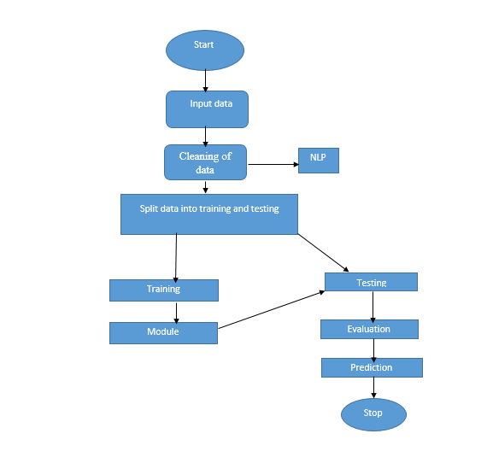
PROPOSED METHOD

Slide 11
ALGORITHMS
1. Random Forest:
A random forest is a machine learning technique that’s used to solve regression and classification problems. It utilizes ensemble learning, which is a technique that combines many classifiers to provide solutions to complex problems.
A random forest algorithm consists of many decision trees. The ‘forest’ generated by the random forest algorithm is trained through bagging or bootstrap aggregating. Bagging is an ensemble meta-algorithm that improves the accuracy of machine learning algorithms.
The (random forest) algorithm establishes the outcome based on the predictions of the decision trees. It predicts by taking the average or mean of the output from various trees. Increasing the number of trees increases the precision of the outcome.
A random forest eradicates the limitations of a decision tree algorithm. It reduces the over fitting of datasets and increases precision. It generates predictions without requiring many configurations in packages (like Scikit-learn).

Slide 12
Features of a Random Forest Algorithm:
• It’s more accurate than the decision tree algorithm.
• It provides an effective way of handling missing data.
• It can produce a reasonable prediction without hyper-parameter tuning.
• It solves the issue of over fitting in decision trees.
• In every random forest tree, a subset of features is selected randomly at the node’s splitting point.
Decision trees are the building blocks of a random forest algorithm. A decision tree is a decision support technique that forms a tree-like structure. An overview of decision trees will help us understand how random forest algorithms work.
A decision tree consists of three components: decision nodes, leaf nodes, and a root node. A decision tree algorithm divides a training dataset into branches, which further segregate into other branches. This sequence continues until a leaf node is attained. The leaf node cannot be segregated further.

Slide 13
2. Neural Networks:
An artificial neural network (ANN) is the piece of a computing system designed to simulate the way the human brain analyses and processes information. It is the foundation of artificial intelligence (AI) and solves problems that would prove impossible or difficult by human or statistical standards. ANNs have self-learning capabilities that enable them to produce better results as more data becomes available.An ANN has hundreds or thousands of artificial neurons called processing units, which are interconnected by nodes. These processing units are made up of input and output units. The input units receive various forms and structures of information based on an internal weighting system, and the neural network attempts to learn about the information presented to produce one output report. Just like humans need rules and guidelines to come up with a result or output, ANNs also use a set of learning rules called back propagation, an abbreviation for backward propagation of error, to perfect their output results. An ANN initially goes through a training phase where it learns to recognize patterns in data, whether visually, aurally, or textually. During this supervised phase, the network compares its actual output produced with what it was meant to produce—the desired output. The difference between both outcomes is adjusted using back propagation.

Slide 14
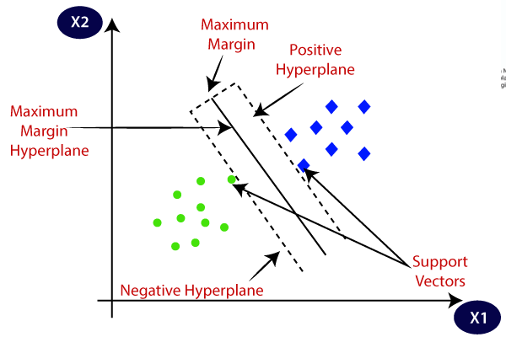
3. Support Vector Machine:
Support Vector Machine or SVM is one of the most popular Supervised Learning algorithms, which is used for Classification as well as Regression problems. However, primarily, it is used for Classification problems in Machine Learning. The goal of the SVM algorithm is to create the best line or decision boundary that can segregate n-dimensional space into classes so that we can easily put the new data point in the correct category in the future. This best decision boundary is called a hyperplane. SVM chooses the extreme points/vectors that help in creating the hyperplane. These extreme cases are called as support vectors, and hence algorithm is termed as Support Vector Machine.

Slide 15
4. LOGISTIC REGRESSION
Logistic Regression was used in the biological sciences in early twentieth century. It was then used in many social science applications. Logistic Regression is used when the dependent variable (target) is categorical.
For example,
To predict whether an email is spam (1) or (0)
Whether the tumor is malignant (1) or not (0)
Consider a scenario where we need to classify whether an email is spam or not. If we use linear regression for this problem, there is a need for setting up a threshold based on which classification can be done. Say if the actual class is malignant, predicted continuous value 0.4 and the threshold value is 0.5, the data point will be classified as not malignant which can lead to serious consequence in real time.
From this example, it can be inferred that linear regression is not suitable for classification problem. Linear regression is unbounded, and this brings logistic regression into picture. Their value strictly ranges from 0 to 1.

Slide 16
5.Decision Tree
A tree has many analogies in real life, and turns out that it has influenced a wide area of machine learning, covering both classification and regression. In decision analysis, a decision tree can be used to visually and explicitly represent decisions and decision making. As the name goes, it uses a tree-like model of decisions. Though a commonly used tool in data mining for deriving a strategy to reach a particular goal.
A decision tree is drawn upside down with its root at the top. In the image on the left, the bold text in black represents a condition/internal node, based on which the tree splits into branches/ edges. The end of the branch that doesn’t split anymore is the decision/leaf, in this case, whether the passenger died or survived, represented as red and green text respectively.
Although, a real dataset will have a lot more features and this will just be a branch in a much bigger tree, but you can’t ignore the simplicity of this algorithm. The feature importance is clear and relations can be viewed easily. This methodology is more commonly known as learning decision tree from data and above tree is called Classification tree as the target is to classify passenger as survived or died.

Slide 17
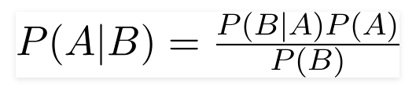
6.NAIVE BAYES:
A Naive Bayes classifier is a probabilistic machine learning model that’s used for classification task. The crux of the classifier is based on the Bayes theorem.
Using Bayes theorem, we can find the probability of A happening, given that B has occurred. Here, B is the evidence and A is the hypothesis. The assumption made here is that the predictors/features are independent. That is presence of one particular feature does not affect the other. Hence it is called naive.
Let’s understand it using an example. Below I have a training data set of weather and corresponding target variable ‘Play’ (suggesting possibilities of playing). Now, we need to classify whether players will play or not based on weather condition. Let’s follow the below steps to perform it.
Step 1: Convert the data set into a frequency table
Step 2: Create Likelihood table by finding the probabilities like Overcast probability = 0.29 and probability of playing is 0.64.

Slide 18
7. XGBoost
XGBoost stands for “Extreme Gradient Boosting”. XGBoost is an optimized distributed gradient boosting library designed to be highly efficient, flexible and portable. It implements Machine Learning algorithms under the Gradient Boosting framework. It provides a parallel tree boosting to solve many data science problems in a fast and accurate way.
Boosting
Boosting is an ensemble learning technique to build a strong classifier from several weak classifiers in series. Boosting algorithms play a crucial role in dealing with bias-variance trade-off. Unlike bagging algorithms, which only controls for high variance in a model, boosting controls both the aspects (bias & variance) and is considered to be more effective.
Below are the few types of boosting algorithms:
AdaBoost (Adaptive Boosting)
Gradient Boosting
XGBoost
CatBoost
Light GBM

Slide 19
8.LSTM:
Cannot handle sequential data
Considers only the current input
Cannot memorize previous inputs
The solution to these issues is the Recurrent Neural Network (RNN). An RNN can handle sequential data, accepting the current input data, and previously received inputs. RNNs can memorize previous inputs due to their internal memory.
It is a variety of recurrent neural networks (RNNs) that are capable of learning long-term dependencies, especially in sequence prediction problems. LSTM has feedback connections, i.e., it is capable of processing the entire sequence of data, apart from single data points such as images.
The central role of an LSTM model is held by a memory cell known as a ‘cell state’ that maintains its state over time. The cell state is the horizontal line that runs through the top of the below diagram. It can be visualized as a conveyor belt through which information just flows, unchanged.

Slide 20
9. CNN(Convolutional neural Network):
Convolutional Neural Networks were developed as a result of the fact that only some individual neuronal cells in the brain fire when certain orientation edges are present. For example, some neurons respond when exposed to vertical edges, while others respond when exposed to horizontal or diagonal edges.
Convolutional neural networks, sometimes referred to as covnets, are neural networks with shared parameters, to put it simply. Think of a cuboid-shaped picture with the following measurements: length, width, and height. The Red, Green, and Blue channels here provide as an example of the size of the picture,

Slide 21
10. BERT:
BERT is an open-source library created in 2018 at Google. It's a new technique for NLP and it takes a completely different approach to training models than any other technique.
BERT is an acronym for Bidirectional Encoder Representations from Transformers. That means unlike most techniques that analyze sentences from left-to-right or right-to-left, BERT goes both directions using the Transformer encoder. Its goal is to generate a language model.
This gives it incredible accuracy and performance on smaller data sets which solves a huge problem in natural language processing.
While there is a huge amount of text-based data available, very little of it has been labeled to use for training a machine learning model. Since most of the approaches to NLP problems take advantage of deep learning, you need large amounts of data to train with.
You really see the huge improvements in a model when it has been trained with millions of data points. To help get around this problem of not having enough labelled data, researchers came up with ways to train general purpose language representation models through pre-training using text from around the internet.

Slide 22
UML DIAGRAMS
UML stands for Unified Modelling Language. UML is a standardized general-purpose modelling language in the field of object-oriented software engineering. The standard is managed, and was created by, the Object Management Group. The goal is for UML to become a common language for creating models of object-oriented computer software. In its current form UML is comprised of two major components: a Meta-model and a notation. In the future, some form of method or process may also be added to; or associated with, UML.
The Unified Modelling Language is a standard language for specifying, Visualization, Constructing and documenting the artifacts of software system, as well as for business modelling and other non-software systems.
The UML represents a collection of best engineering practices that have proven successful in the modelling of large and complex systems.
The UML is a very important part of developing objects-oriented software and the software development process. The UML uses mostly graphical notations to express the design of software projects

Slide 23
GOALS:
The Primary goals in the design of the UML are as follows:
Provide users a ready-to-use, expressive visual modelling Language so that they can develop and exchange meaningful models.
Provide extendibility and specialization mechanisms to extend the core concepts.
Be independent of particular programming languages and development process.
Provide a formal basis for understanding the modelling language.
Encourage the growth of OO tools market.
Support higher level development concepts such as collaborations, frameworks, patterns and components.
Integrate best practices.

Slide 24
Use case diagram:
A use case diagram in the unified modeling language (uml) is a type of behavioral diagram defined by and created from a use-case analysis. Its purpose is to present a graphical overview of the functionality provided by a system in terms of actors, their goals (represented as use cases), and any dependencies between those use cases. The main purpose of a use case diagram is to show what system functions are performed for which actor. Roles of the actors in the system can be depicted.

Slide 25
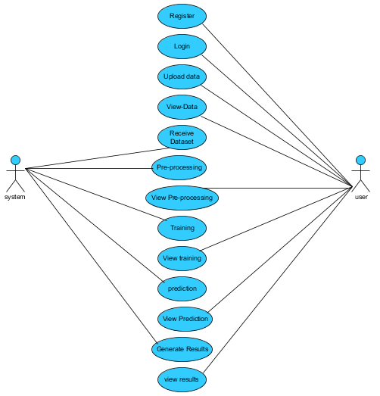

Slide 26
Class diagram:
In software engineering, a class diagram in the unified modeling language (uml) is a type of static structure diagram that describes the structure of a system by showing the system's classes, their attributes, operations (or methods), and the relationships among the classes. It explains which class contains information.

Slide 27
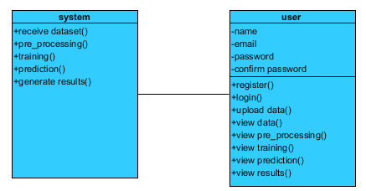

Slide 28
Sequence diagram:
A sequence diagram in unified modeling language (uml) is a kind of interaction diagram that shows how processes operate with one another and in what order. It is a construct of a message sequence chart. Sequence diagrams are sometimes called event diagrams, event scenarios, and timing diagrams.

Slide 29
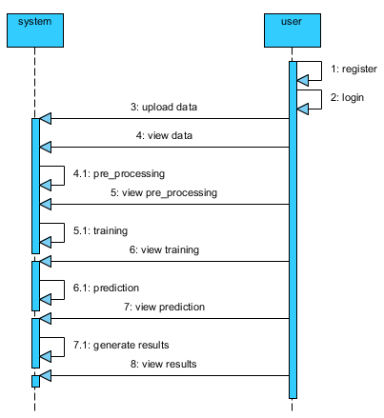

Slide 30
Collaboration diagram:
In collaboration diagram the method call sequence is indicated by some numbering technique as shown below. The number indicates how the methods are called one after another. We have taken the same order management system to describe the collaboration diagram. The method calls are similar to that of a sequence diagram. But the difference is that the sequence diagram does not describe the object organization whereas the collaboration diagram shows the object organization.

Slide 31
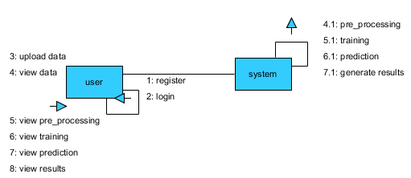

Slide 32
Deployment diagram:
Deployment diagram represents the deployment view of a system. It is related to the component diagram. Because the components are deployed using the deployment diagrams. A deployment diagram consists of nodes. Nodes are nothing but physical hard ware’s used to deploy the application.

Slide 33


Slide 34
Component diagram:
Component diagrams are used to describe the physical artifacts of a system. This artifact includes files, executable, libraries etc. So the purpose of this diagram is different, component diagrams are used during the implementation phase of an application. But it is prepared well in advance to visualize the implementation details. Initially the system is designed using different uml diagrams and then when the artifacts are ready component diagrams are used to get an idea of the implementation.

Slide 35
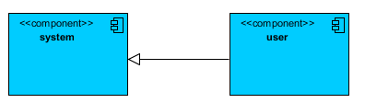

Slide 36
Activity diagram:
Activity diagrams are graphical representations of workflows of stepwise activities and actions with support for choice, iteration and concurrency. In the unified modeling language, activity diagrams can be used to describe the business and operational step-by-step workflows of components in a system. An activity diagram shows the overall flow of control.

Slide 37
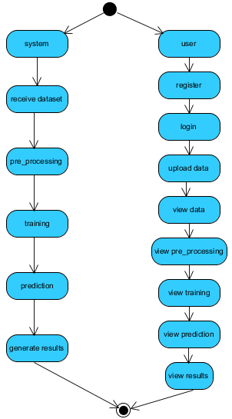

Slide 38
ER Diagram:
An Entity–relationship model (ER model) describes the structure of a database with the help of a diagram, which is known as Entity Relationship Diagram (ER Diagram). An ER model is a design or blueprint of a database that can later be implemented as a database. The main components of E-R model are: entity set and relationship set.

Slide 39
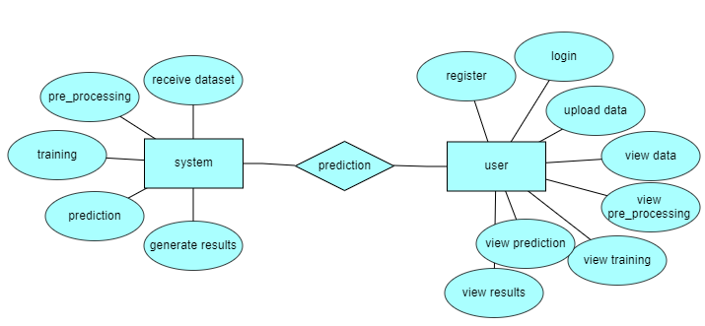

Slide 40
DFD Diagram:
A Data Flow Diagram (DFD) is a traditional way to visualize the information flows within a system. A neat and clear DFD can depict a good amount of the system requirements graphically. It can be manual, automated, or a combination of both. It shows how information enters and leaves the system, what changes the information and where information is stored. The purpose of a DFD is to show the scope and boundaries of a system as a whole. It may be used as a communications tool between a systems analyst and any person who plays a part in the system that acts as the starting point for redesigning a system.

Slide 41
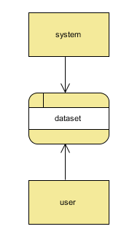
Context Level Diagram:

Slide 42
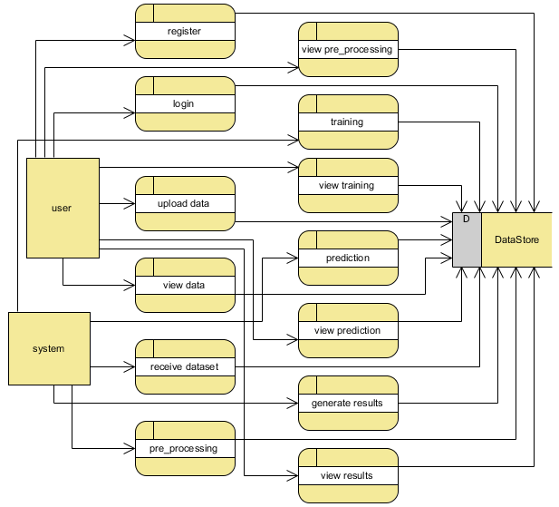
Level 1 Diagram:

Slide 43
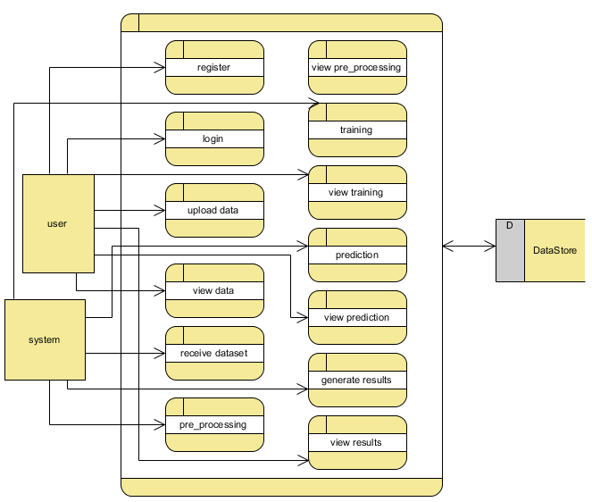
Level 2 Diagram:

Slide 44

OUTPUT SCREEN SHOTS WITH DESCRIPTION.
Home Page:
Fig2: Home Page

Slide 45
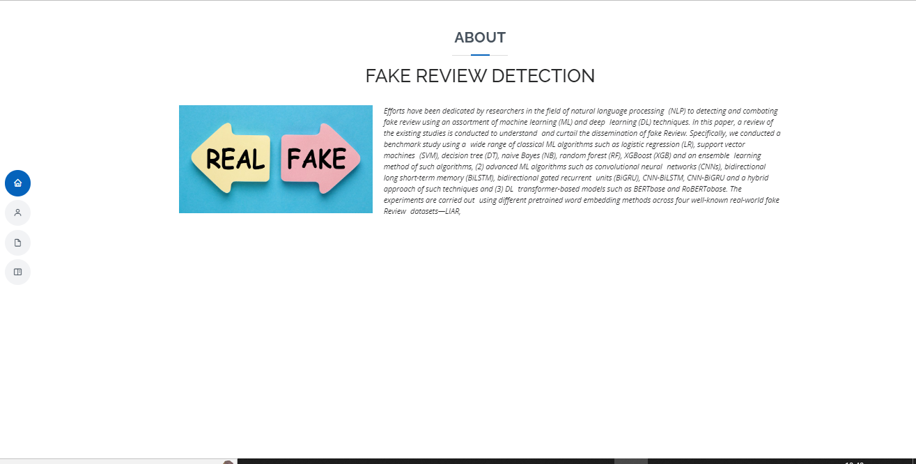
About:
Fig3:About page.

Slide 46
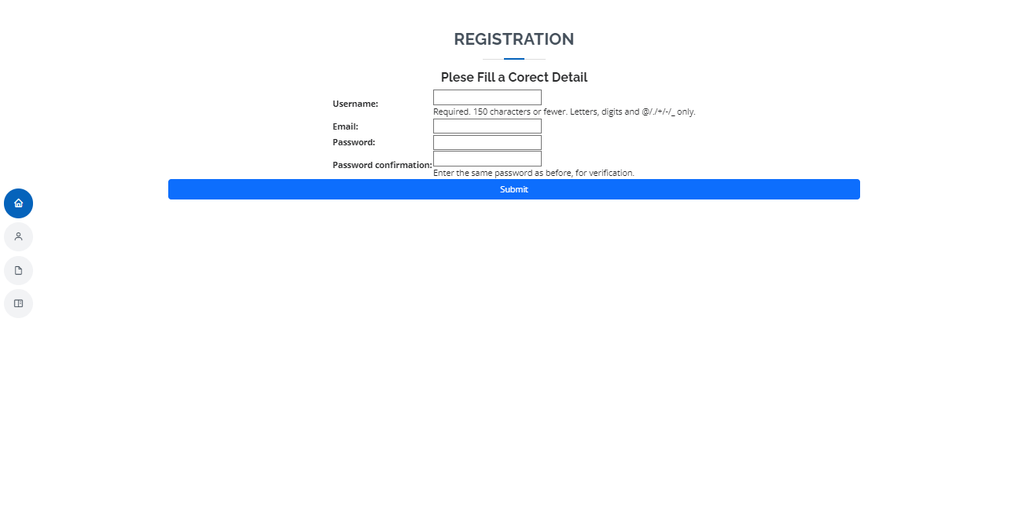
User Registration page: User can register with required details.
Fig3:Registration page.

Slide 47
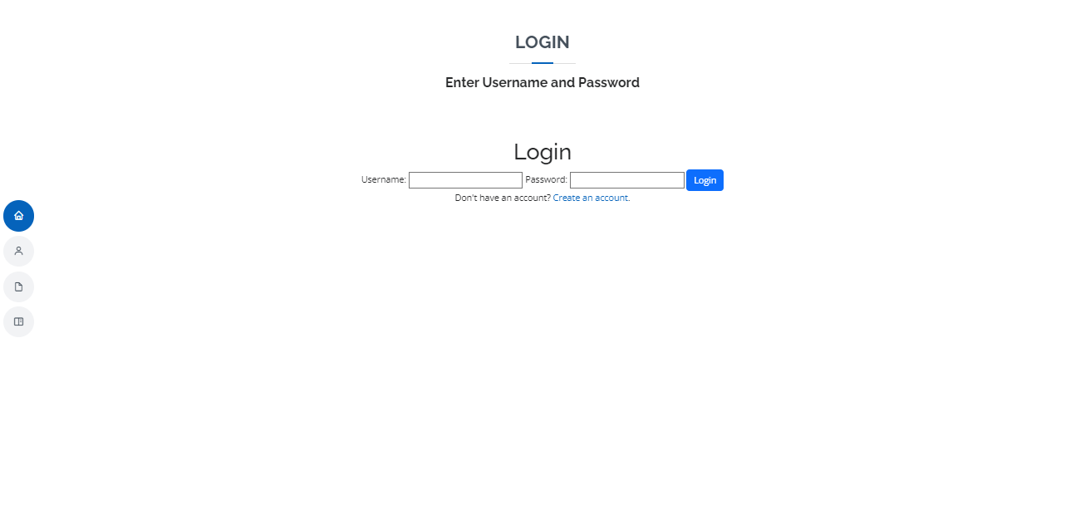
User Login: User can login with valid credentials.
Fig4:Login page.

Slide 48

User Home page: User can view the home page after successful login.
Fig5:Uaer Hoam page.

Slide 49
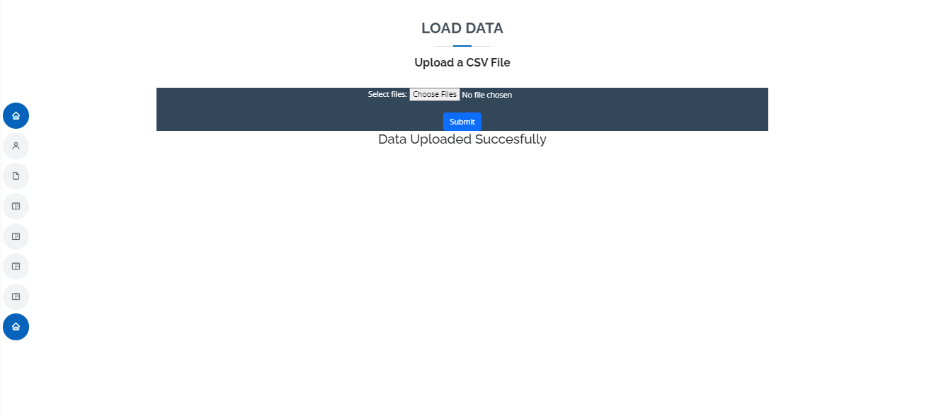
Upload data:
Fig6:Upload Data.

Slide 50
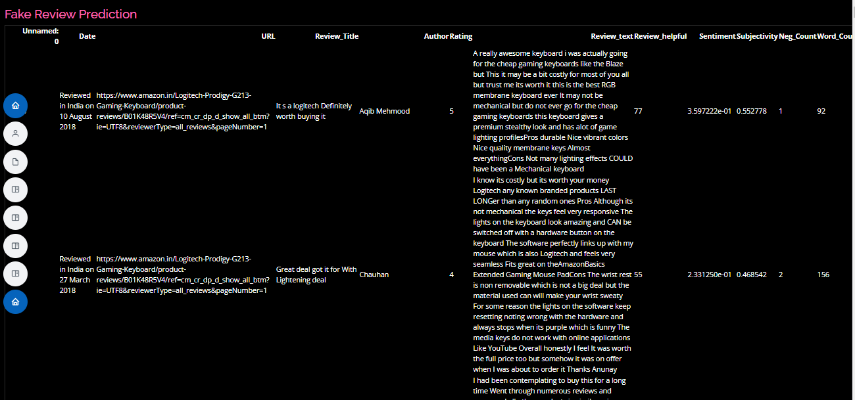
View:
Fig7: View.

Slide 51
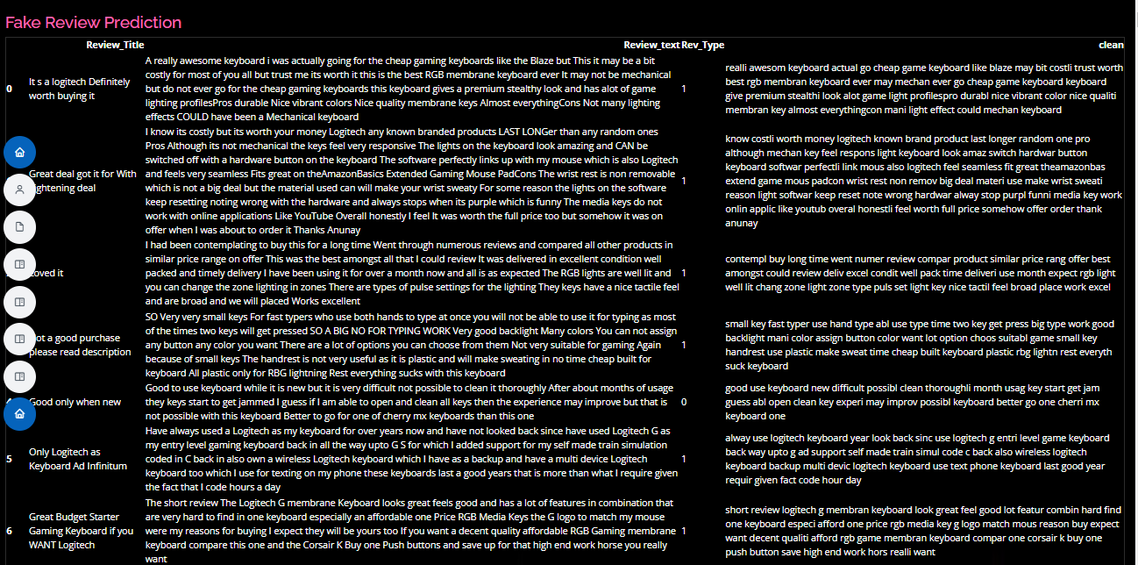
PREPROCESSING:
Fig7: Preprocessing.

Slide 52

Training:
We’re training the algorithm to see which one has the best accuracy.
Fig8: Training Algorithm

Slide 53

Prediction:
Fig9: Prediction

Slide 54
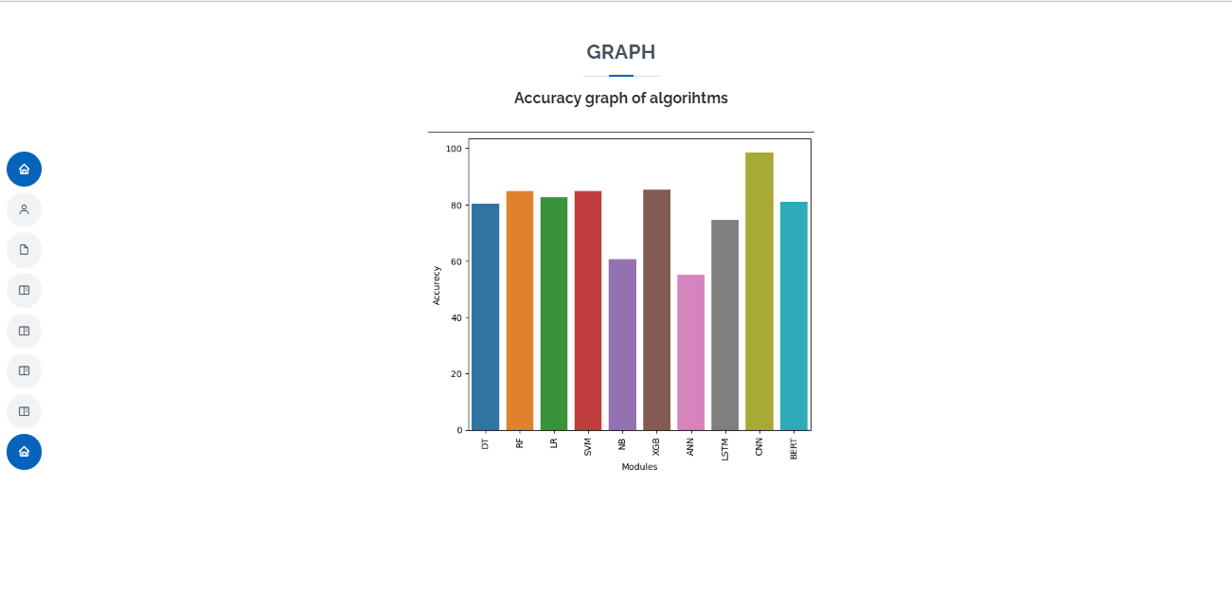
Graph:
Fig9: Graph

Slide 55
CONCLUSION
In this project, we have developed a user friendly application called a comparative study of machine learning and deep learning techniques for fake review detection Using Machine Learning Model techniques and take a fake review data set and applying some NLP Concepts and ML and DL algorithm Techniques such as Decision Tree, Random Forest, SVC, CNN, Naïve Bias, Logistic Regression, XGBoost, ANN, LSTM, BERT We used the best techniques we found and its show the weather it’s a bad Review are its Genuine Review.

Slide 56
REFERENCES
[1] E. F. Cardoso, R. M. Silva, and T. A. Almeida, ‘‘Towards automatic filtering of fakereviews,’’ Neurocomputing, vol. 309, pp. 106–116, Oct. 2018.
[2] L. Da Xu, W. He, and S. Li, ‘‘Internet of Things in industries: A survey,’’IEEE Trans. Ind. Informat., vol. 10, no. 4, pp. 2233–2243, Nov. 2014.
[3] Y. Ren and Y. Zhang, ‘‘Deceptive opinion spam detection using neural network,’’ in Proc.26th Int. Conf. Comput. Linguistics: Tech.Papers (COLING), 2016, pp. 140–150.
[4] N. Jindal and B. Liu, ‘‘Opinion spam and analysis,’’ in Proc. Int. Conf.Web Search Web Data Mining (WSDM), 2008, pp. 219–230.
[5] A. Heydari, M. Tavakoli, and N. Salim, ‘‘Detection of fake opinions usingtime series,’’ Expert Syst. Appl., vol. 58, pp. 83–92, Oct. 2016.

Slide 57
[6] L. Li, W. Ren, B. Qin, and T. Liu, ‘‘Learning document representation fordeceptive opinion spam detection,’’ in Chinese Computational Linguisticsand Natural Language Processing Based on Naturally Annotated BigData. Nanjing, China: Springer, 2015, pp. 393–404.
[7] H. Aghakhani, A. Machiry, S. Nilizadeh, C. Kruegel, and G. Vigna,‘‘Detecting deceptive reviews using generative adversarial networks,’’ inProc. IEEE Secur. Privacy Workshops (SPW), May 2018, pp. 89–95.
[8] A. Mukherjee, V. Venkataraman, B. Liu, and N. Glance, ‘‘Fake reviewdetection: Classification and analysis of real and pseudo reviews,’’ Univ.Illinois Chicago, Chicago, IL, USA, Tech. Rep. UIC-CS-03-2013, 2013.
[9] R. Yafeng, J. Donghong, Z. Hongbin, and Y. Lan, ‘‘Deceptive reviewsdetection based on positive and unlabeled learning,’’ J. Comput. Res.Develop., vol. 52, no. 3, p. 639, 2015.
[10] R. Y. K. Lau, S. Y. Liao, R. C.-W. Kwok, K. Xu, Y. Xia, and Y. Li,‘‘Text mining and probabilistic language modeling for online reviewspam detection,’’ ACM Trans. Manage. Inf. Syst., vol. 2, no. 4, pp. 1–30,Dec. 2011.

Slide 58



